Slide 1
Microprocessor

Slide 2
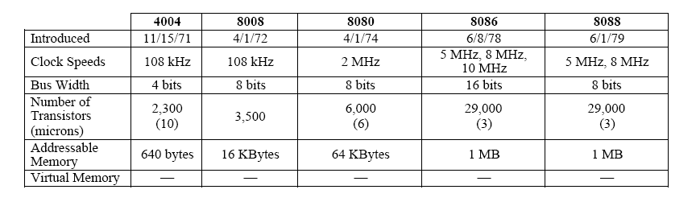
Evolution of Intel Microprocessors
1970s Processors

Slide 3
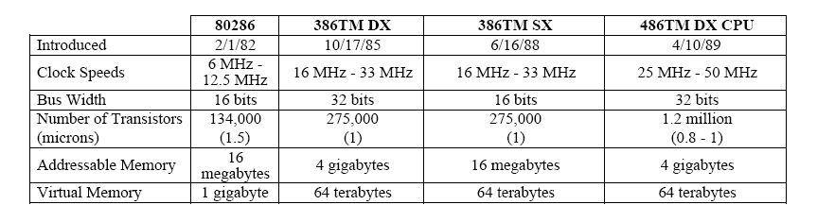
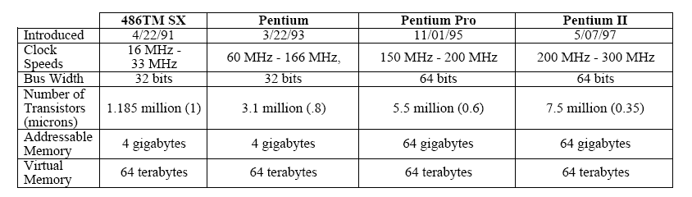
1980s Processors
1990s Processors

Slide 4
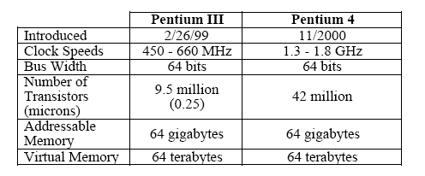
Upto 2000 Processors

Slide 5
The 4-Bit Microprocessor
Released by Intel in 1971.
Named as 4004.
It is 4-bit microprocessor.
It can address 640 4-bit memory locations.
As a result, it could be used in very limited applications

Slide 6
The 8-Bit Microprocessor
Later in 1972, Intel released the 8008, an 8-bit microprocessor.
It had a total of 48 instructions.
It could address 16K 8-bit memory locations.
In 1974, Intel introduced the 8080, the first of the modern and second 8-bit microprocessors.
The 8080 could execute more instructions than the 8008
An addition that took 20 μs on an 8008 took only 2 μs on an 8080.

Slide 7
The 8-Bit Microprocessor
8085 was a newer version of 8080, again introduced by Intel in 1976.
The 8085 addresses the same amount of memory, executed about the same number of instructions.
However it was a little faster than the 8080 in that sense that an addition instruction which took about 2 μs on an 8080 took only 1.3 μs on an 8085.
The main advantage of an 8085 is its built-in clock and system controller which was external components on an 8080 based system.

Slide 8
The 16-Bit Microprocessor
In 1978, the Intel Corporation released the 8086 microprocessor and a year later the 8088.
8086 was 16-bit and 8088 was 8-bit and execute instructions in as little time as 400 ns.
Both can address 1 Mbytes of memory.

Slide 9
Basic 8086 Architecture

Slide 10
Basic Internal Architecture Of 8085
The instruction is fetched from the memory by a memory-read cycle.
When the 8085 execute the instruction, the memory system is idle.

Slide 11
Basic Internal Architecture Of 8086
The 8086 make use of this idle time by pre-fetching the next instruction while the current instruction is being executed.
Here the bus is always busy.
The 8088 and 8086 contains two internal units; the execution unit (EU) and the bus interface unit (BIU).

Slide 12
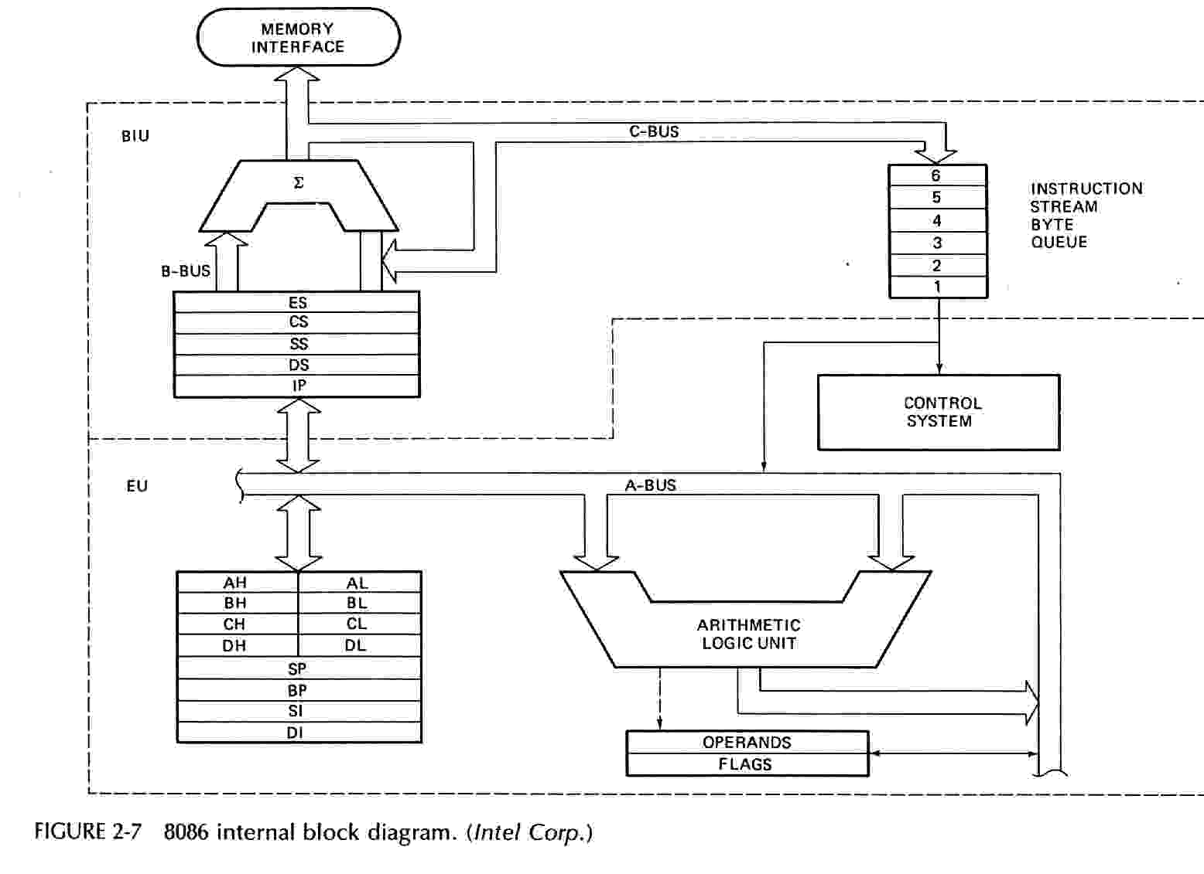
8086 Block Diagram
Prof. Virender Kumar Ranga

Slide 13
Basic Internal Architecture Of 8086
The BIU is responsible for fetching an instruction or the operand of an instruction from the memory.
The EU is responsible for executing the instructions.
The 8086 is able to utilize the bus with maximum efficiency because it contain internal memory in the form of a queue.
The 8086 queue is 6 bytes. It is therefore able to hold three 16-bit numbers.

Slide 14
The Bus Interface Unit (BIU)
The BIU contains a prefetch queue, a bus controller, segment registers and the instruction pointer.
The main purposes of the BIU are:
  To keep the prefetch queue filled with instructions.
  To provide the system with a memory address or I/O port number.
  To act as a window between the EU and memory for data.

Slide 15
The Execution Unit (EU)
The purpose of the EU is to carry out instructions that are fetched from the prefetch queue.
It contains; an arithmetic and logic unit, an instruction register, and a register array.
The ALU performs arithmetic and logic operations on memory and or register data.
The instruction register receives the instructions from the prefetch queue. From here these instructions are decoded to direct the operation of the execution unit.
The register array holds information temporarily. It also contains pointers or index registers used to address operand data located in the memory.
The flag register is used to tell the status of last executed instruction.

Slide 16
System Architecture
Three types of buses are:
  Address Bus
  Data Bus
  Control Bus

Slide 17
System Architecture
The address bus provides the memory address to the system memory and also I/O addresses to the I/O devices. 8086 has a 20-bit address bus.
The data bus transfers data between the microprocessor and the memory and I/O attached to the system. 8086 has 16-bit data bus.
The control bus provides control signals that cause the memory or I/O to perform a READ or WRITE operation. It consists of three signals RD, WR and IO/M.

Slide 18
System Architecture
The 16-bit data bus on the 8086 allows it to fetch instructions more quickly than the 8088 because it fetches them 2 bytes rather than 1 byte at a time.
Both microprocessors address 1M bytes of memory because they both contain a 20-bit address bus.

Slide 19
Memory Model of 8086 and 8088
Although both 8086 and 8088 microprocessors address 1048576 (1M) bytes of memory, they differ in physical memory organization.
We can bifurcate memory into two categories:
1. Logical Memory
2. Physical Memory

Slide 20
Memory Model of 8086 and 8088
Logical Memory
The logical memory space is the same for both 8086 and 8088 microprocessors.
Logical memory is the name given to memory viewed by the programmer through the software.
It may be different from the physical memory in the system, which is the actual organization of the memory that the hardware designer sees.

Slide 21
Memory Model of 8086 and 8088
Logical Memory
The logical memory for both 8088 and 8086 begins at memory locations 00000H and extends to location FFFFFH.
The logical memory is 8-bit wide.
This range of addresses specifies the 1M bytes of memory available in the system.
A 16-bit word of memory addressed by either microprocessor begins at any byte address and extends for 2 consecutive bytes.

Slide 22
Memory Model of 8086 and 8088
Physical Memory
The physical memories of the 8086 and 8088 differ in width.
The 8086 memory is 16 bits wide, and the 8088 memory is 8-bit wide.
For programming, there is no difference, that is, memory is always 8-bit wide.
But there is a difference for the hardware designer.

Slide 23
Memory Model of 8086 and 8088
8088 Physical Memory
It is identical to the logical memory as discussed earlier.

Slide 24
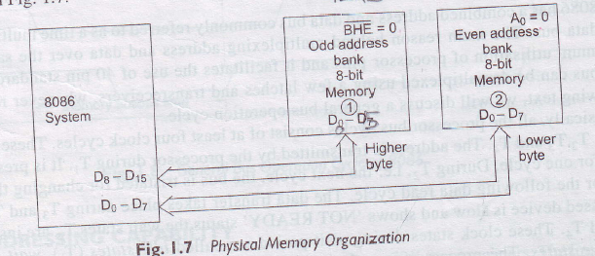
Memory Model of 8086

Slide 25
Memory Model of 8086
8086 Physical Memory
It contains two distinct banks of memory: the odd bank and the even bank.
Each bank of memory is 512K x 8.
The total addressable space is still 1 M bytes.
The advantage of this organization is that the 8086 can directly address any byte or word of data.
It therefore, reads or writes a 16-bit word in one operation while the 8088 requires two read or write operations to transfer 16 bit of data.
Hence 8086 executes more efficiently, because it accesses many instructions and 16-bit data at twice the speed of the 8088.

Slide 26
8086 Architecture( Cont.)
  The BIU contains the following registers:
    IP - the Instruction Pointer
    CS - the Code Segment Register
    DS - the Data Segment Register
    SS - the Stack Segment Register
    ES - the Extra Segment Register
The BIU fetches instructions using the CS and IP,
written CS:IP, to construct the 20-bit address. Data
is fetched using a segment register (usually the DS)
and an effective address (EA) computed by the EU
depending on the addressing mode.
Prof. Virender Kumar Ranga

Slide 27
8086 Architecture ]
The EU contains the following 16-bit registers:
        AX - the Accumulator
        BX - the Base Register
        CX - the Count Register
        DX - the Data Register
        SP - the Stack Pointer
        BP - the Base Pointer
        SI - the Source Index Register
        DI - the Destination Register
These are referred to as general-purpose registers, although, as seen by their names, they often have a special-purpose use for some instructions.
The AX, BX, CX, and DX registers can be considered as two 8-bit registers, a High byte and a Low byte. This allows byte operations and compatibility with the previous generation of 8-bit processors, the 8080 and 8085. The 8-bit registers are:
        AX --> AH,AL
        BX --> BH,BL
        CX --> CH,CL
        DX --> DH,DL
Default to stack segment
Prof. Virender Kumar Ranga

Slide 28
8086 Architecture
The EU also contains the Flag Register which is a collection of
condition bits and control bits. The condition bits are set or
cleared by the execution of an instruction. The control bits are set
by instructions to control some operation of the CPU.
    Bit 0 - CF Carry Flag - Set by carry out of MSB
    Bit 2 - PF Parity Flag - Set if result has even parity
    Bit 4 - AF Auxiliary Flag - for BCD arithmetic
    Bit 6 - ZF Zero Flag - Set if result is zero
    Bit 7 - SF Sign Flag = MSB of result
    Bit 8 - TF Single Step Trap Flag
    Bit 9 - IF Interrupt Enable Flag
    Bit 10 - DF String Instruction Direction Flag
    Bit 11 - OF Overflow Flag
    Bits 1, 3, 5, 12-15 are undefined.
Prof. Virender Kumar Ranga

Slide 29
8086 Programmer’s Model
16-bit Registers
ES
Extra Segment
_{BIU registers}
_{(20 bit adder)}
CS
Code Segment
SS
Stack Segment
DS
Data Segment
IP
Instruction Pointer
AX
AH
AL
Accumulator
BX
BH
BL
Base Register
CX
CH
CL
Count Register
DX
DH
DL
Data Register
SP
Stack Pointer
BP
Base Pointer
_{EU registers}
_{16 bit arithmetic}
SI
Source Index Register
DI
Destination Index Register
FLAGS
Prof. Virender Kumar Ranga

Slide 30
Segments
Segment Starting address is segment register value shifted 4 place to the left.
MEMORY
Address
000000H
CODE
64K Data
Segment
STACK
DATA
EXTRA
64K Code
Segment
← CS:0
Segment
Registers
Segments are < or = 64K,
can overlap, start at an address
that ends in 0H.
0FFFFFH
Prof. Virender Kumar Ranga

Slide 31
8086 Memory Terminology
Memory Segments
Segment
Registers
000000H
001000H
DS:
0100H
DATA
10FFFH
0B2000H
SS:
0B200H
STACK
0C1FFFH
ES:
0CF00H
0CF000H
EXTRA
0DEFFFH
CS:
0FF00H
0FF000H
CODE
0FFFFFH
Segments are < or = 64K and can overlap.
Note that the Code segment is < 64K since 0FFFFFH is the highest address.
Prof. Virender Kumar Ranga

Slide 32
The Code Segment
_{000000H}
4000H
CS:
0400H
4056H
IP
0056H
CS:IP = 400:56
Logical Address
Left-shift 4 bits
Memory
0
Segment Register
Offset
Physical or
Absolute Address
0400
+
0056
_{0FFFFFH}
04056H
The offset is the distance in bytes from the start of the segment.
The offset is given by the IP for the Code Segment.
Instructions are always fetched with using the CS register.
The physical address is also called the absolute address
Prof. Virender Kumar Ranga

Slide 33
The Data Segment
_{000000H}
05C00H
DS:
05C0
05C50H
EA
0050
DS:EA
Memory
05C0
0
Segment Register
Offset
Physical Address
+
0050
_{0FFFFFH}
05C50H
Data is usually fetched with respect to the DS register.
The effective address (EA) is the offset.
The EA depends on the addressing mode.
Prof. Virender Kumar Ranga

Slide 34
Addressing Modes
Assembler directive, DW = Define Word
DATA1 DW 25H DATA1 is defined as a word (16-bit) variable, i.e., a memory location that contains 25H.
DATA2 EQU 20H DATA2 is not a memory location but a constant.
Direct Addressing
MOV AX,DATA1 [DATA1] → AX, the contents of DATA1 is put into AX.
The CPU goes to memory to get data. 25H is put in AX.
Immediate Addressing
MOV AX,DATA2 DATA2 = 20H → AX, 20H is put in AX.
Does not go to memory to get data.
Data is in the instruction.
MOV AX, OFFSET DATA1 The offset of SAM is just a number.
The assembler knows which mode to encode by the way the operands SAM and FRED are defined.

Slide 35
Addressing Modes
Register Addressing MOV AX,BX AX
BX
Register Indirect Addressing
MOV AX,[BX] AX DS:BX
Can use BX or BP -- Based Addressing (BP defaults to SS)
or DI or SI -- Indexed Addressing
The offset or effective address (EA) is in the base or index register.
Register Indirect with Displacement MOV AX,SAM[BX]
Indexed with displacement
Based with displacement
AX DS:BX + Offset SAM
AX
DS:EA
where EA = BX + offset SAM
Based-Indexed Addressing MOV AX,[BX][SI] EA = BX + SI
Based-Indexed w/Displacement MOV AX,SAM[BX][DI]
EA = BX + DI + offset SAM
Prof. Virender Kumar Ranga

Slide 36
Addressing Modes
Branch Related Instructions
NEAR JUMPS and CALLS
Intrasegment
(CS does not change)
Direct -- IP relative displacement
new IP = old IP + displacement
Allows program relocation with
no change in code.
Indirect -- new IP is in memory or a register.
All addressing modes apply.
FAR
Intersegment Direct -- new CS and IP are encoded in
(CS changes) the instruction.
Indirect -- new CS and IP are in memory.
All addressing modes apply
except immediate and register.
Prof. Virender Kumar Ranga

Slide 37
Assembly Language
The Assembler is a program that reads the source program as data and translates the instructions into binary machine code. The assembler outputs a listing of the addresses and machine code along with the
source code and a binary file (object file) with the machine code.
Most assemblers scan the source code twice -- called a two-pass assembler.
  The first pass determines the locations of the labels or identifiers.
  The second pass generates the code.
Prof. Virender Kumar Ranga

Slide 38
Assembly Language
To locate the labels, the assembler has a location counter. This counts the number of bytes required by each instruction.
  When the program starts a segment, the location counter is zero.
  If a previous segment is re-entered, the counter resumes the count.
  The location counter can be set to any offset by the ORG directive.
In the first pass, the assembler uses the location counter to construct a symbol table which contains the offsets or values of the various labels.
The offsets are used in the second pass to generate operand addresses.
Prof. Virender Kumar Ranga

Slide 39
Instruction Set
adc Add with carry flag
add Add two numbers
and Bitwise logical AND
call Call procedure or function
cbw Convert byte to word (signed)
cli Clear interrupt flag (disable interrupts)
cwd Convert word to doubleword (signed)
cmp Compare two operands
dec Decrement by 1
div Unsigned divide
idiv Signed divide
imul Signed multiply
in Input (read) from port
inc Increment by 1
int Call to interrupt procedure
Prof. Virender Kumar Ranga

Slide 40
Instruction Set (Contd.)
iret Interrupt return
j?? Jump if ?? condition met
jmp Unconditional jump
lea Load effective address offset
mov Move data
mul Unsigned multiply
neg Two's complement negate
nop No operation
not One's complement negate
or Bitwise logical OR
out Output (write) to port
pop Pop word from stack
popf Pop flags from stack
push Push word onto stack
Prof. Virender Kumar Ranga

Slide 41
Instruction Set (Contd.)
pushf Push flags onto stack
ret Return from procedure or function
sal Bitwise arithmetic left shift (same as shl)
sar Bitwise arithmetic right shift (signed)
sbb Subtract with borrow
shl Bitwise left shift (same as sal)
shr Bitwise right shift (unsigned)
sti Set interrupt flag (enable interrupts)
sub Subtract two numbers
test Bitwise logical compare
xor Bitwise logical XOR
Prof. Virender Kumar Ranga

Slide 42
Conditional Jumps
Name/Alt Meaning Flag setting
JE/JZ Jump equal/zero ZF = 1
JNE/JNZ Jump not equal/zero ZF = 0
JL/JNGE Jump less than/not greater than or = (SF xor OF) = 1
JNL/JGE Jump not less than/greater than or = (SF xor OF) = 0
JG/JNLE Jump greater than/not less than or = ((SF xor OF) or ZF) = 0
JNG/JLE Jump not greater than/ less than or = ((SF xor OF) or ZF) = 1
JB/JNAE Jump below/not above or equal CF = 1
JNB/JAE Jump not below/above or equal CF = 0
JA/JNBE Jump above/not below or equal (CF or ZF) = 0
JNA/JBE Jump not above/ below or equal (CF or ZF) = 1
JS Jump on sign (jump negative) SF = 1
JNS Jump on not sign (jump positive) SF = 0
JO Jump on overflow OF = 1
JNO Jump on no overflow OF = 0
JP/JPE Jump parity/parity even PF = 1
JNP/JPO Jump no parity/parity odd PF = 0
JCXZ Jump on CX = 0 ---
Prof. Virender Kumar Ranga

Slide 43
More Assembler Directives
ASSUME Tells the assembler what segments to use.
SEGMENT Defines the segment name and specifies that the
        code that follows is in that segment.
ENDS End of segment
ORG Originate or Origin: sets the location counter.
END End of source code.
NAME Give source module a name.
DW Define word
DB Define byte.
EQU Equate or equivalence
LABEL Assign current location count to a symbol.
$ Current location count
Prof. Virender Kumar Ranga

Slide 44
?
Prof. Virender Kumar Ranga

